Slide 1
Google Earth Initiative
William Ganley, James Warner, Michael Shimony

Slide 2
Background
Initiative task to investigate Google Earth
Standalone application versus browser plug-in
Standalone application uses COM API
Support ended in 2008 with the release of browser plug-in
Browser plug-in
JavaScript API
Support for
Windows (XP and Vista)
Mac OS X 10.5 and higher
Requires Internet connection for API
Google Earth is free for personal use
Google Earth Pro requires paid license for commercial uses
MSE Initiative used the free version

Slide 3
Pros and Cons
Pros
Easy to use
Robust API
Excellent documentation
https://developers.google.com/earth/documentation/reference/
Many examples online
Can use Google Maps API inside Google Earth
GeoCoding locations, driving directions, etc.
KML support
Useful as offline planning tool
Cons
Browser plugin support for Windows/Mac only
No mobile support (iOS, Android)
Requires internet connection
API functionality, map tiles, external KML data
Cannot support real-time updates
Transaction limits
Free version has transaction limits for certain functionality (e.g. geocoding)
Google Earth Pro license $400/year
Increased transactions

Slide 4
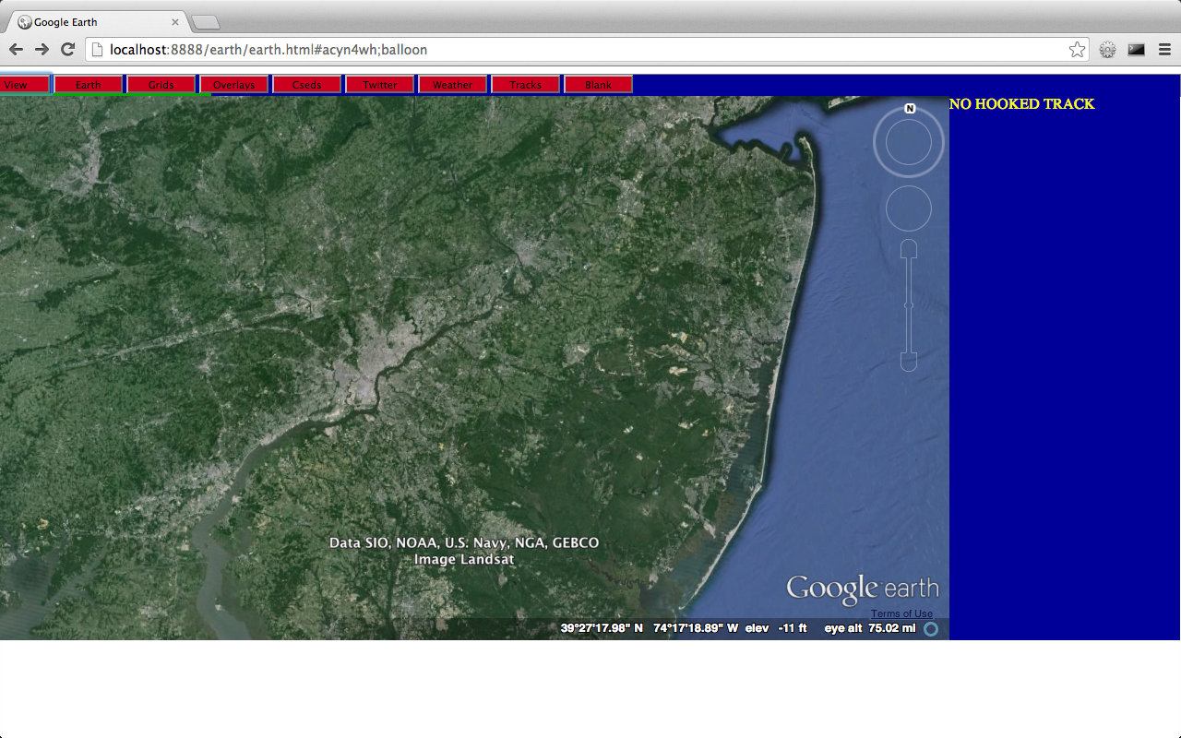
Prototype Design
Laptop running MAMP
HTML/JavaScript/
jQuery/CSS
MySQL
Apache Webserver
Ajax/JSON
PHP/JSON/
KML

Slide 5
Prototype Code
Code
55 html files
42 php files
2 css files
All code saved to https://github.com/MissionSE/Initiatives

Slide 6
Features explored under MSE Initiative
Google Earth control from browser windows
View Control
Offset view
Locations (name, address, position), tracks
Range in/out
Camera tilt
Google Earth built-in features
Sunlight coverage
Inset Map
Roads, borders, buildings, terrain, atmosphere
Earth/Sky map
Lat/Lon grid
Display of KML information
Downloaded KML files for many features

Slide 7
Features explored under MSE Initiative
Custom built features
Tracks
Mil-Std 2525B track symbols
Image files dynamically requested from website
http://dev.bridgeborn.com/symbology
Add/Modify/Delete
Simulator
Symbol sizes
Tags
Filter (category and id)
Weather Feed
Twitter integration
Range rings
Remote control of GE
View tour created in standalone application
Add/Delete operator entered tours
Save lat/lon, range, camera tilt of selected locations for playback via KML
Add/Delete operator entered avoidance areas

Slide 8
Demo

